Slide 1


Slide 2
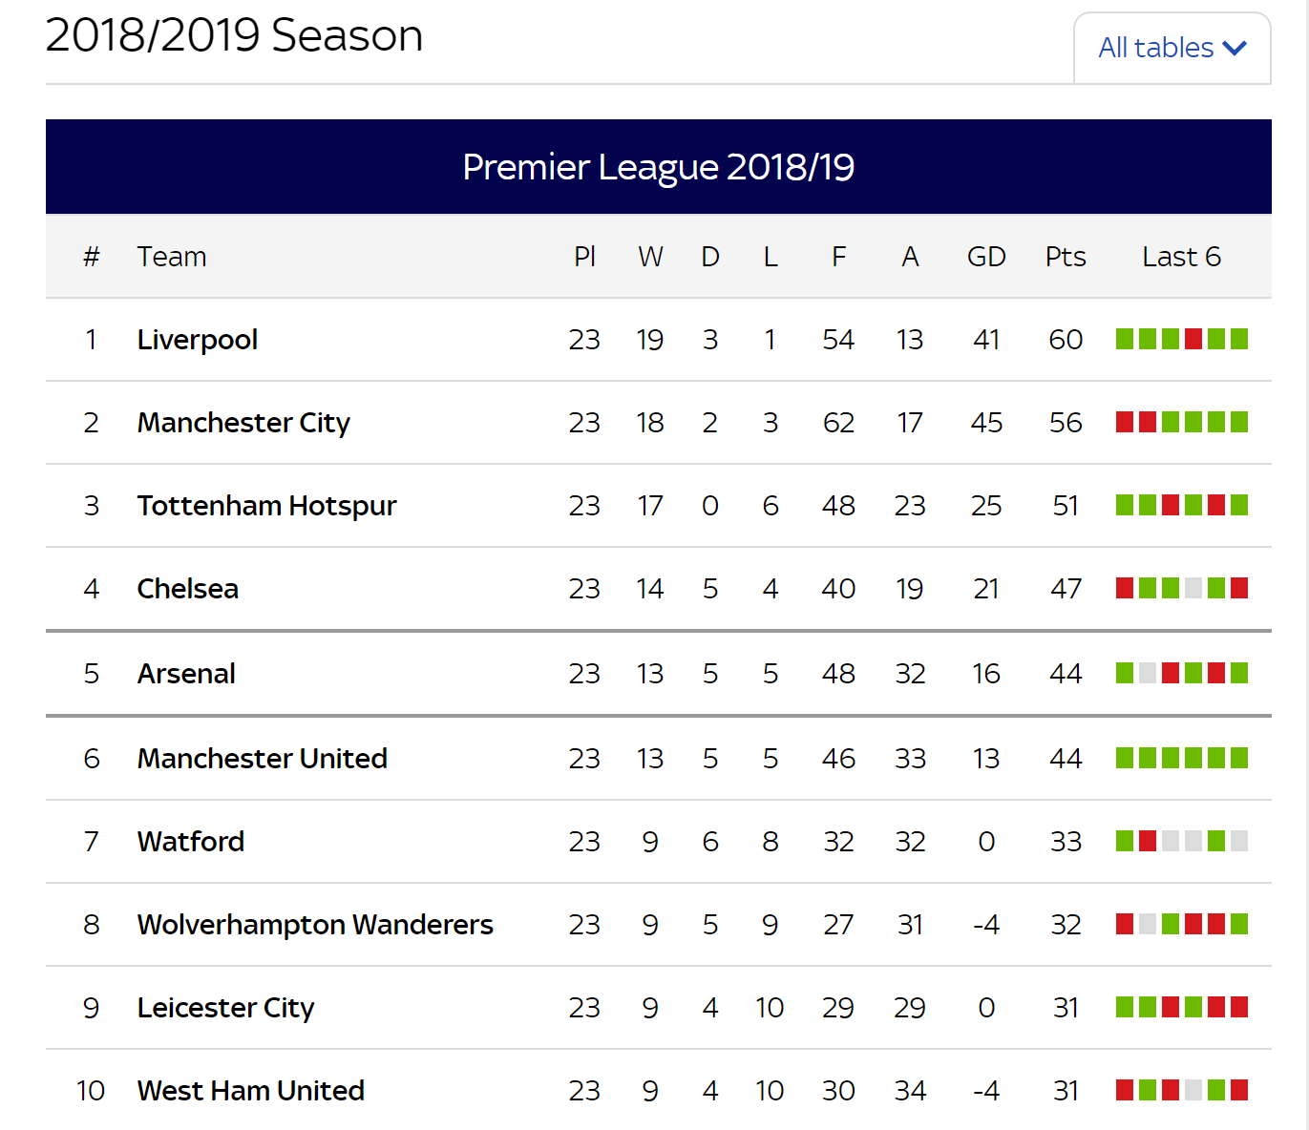











1 |  | 6
2 |  | 7
3 |  | 8
4 |  | 9
5 |  | 10

Slide 3

Introduction
Erer
Erer
erer

Slide 4
Why do we care?
Erer
Erer
erer

Slide 5
What do you want to find out?
Erer
Erer
erer

Slide 6
What have you uncovered?
Erer
Erer
erer

Slide 7
Future Work
Erer
Erer
erer

